Slide 1

An Ontology for the Detection of Malware Behavior in Executables
Emily Miller
Advisor: Dr. Cogan Shimizu

Slide 2
Table of Contents
Introduction
Background
Approach
Results
Conclusion

Slide 3
Introduction
Malware has evolved significantly in the past decade
Average data breach cost $3.86 million in 2023 [1]
Malware analysis techniques
Dynamic vs Static analysis [2]
Software reverse engineering for analyzing malware
Research goal: construct an ontology to represent reverse engineering process for malware
Notes:
Malware, also known as malicious software, is a program or piece of software that is built to disrupt a system or compromise data in some way through taking advantage of system or human vulnerabilities. The market for malware has increased drastically over the past decade with more data and systems being online, so malware has evolved significantly to be able to compromise more systems. The average cost of a data breach for companies in 2023 was almost $4 million dollars, with that amount only increasing in the past few years.
Because of these major impacts to security and economic factors, there has been much effort put into analyzing malware to combat it and make systems more secure. Many analysis techniques have been created for this purpose.
The two main categories of analysis are dynamic analysis and static analysis.
Dynamic analysis consists of running the malicious program in a controlled environment like a virtual machine to observe its behavior. While this method can find behaviors of the program that could not be detected otherwise, it can be risky because some types of malware can detect if it is within a virtual machine and can break out of it, or if the vm is connected to the network some types of malware can spread through there
Static analysis, on the other hand, consists of analyzing code structures without ever actually running the program. This is overall a safer option for analyzing malware and can still be very effective in figuring out how a malicious program works.
One of the methods of conducting static analysis is through software reverse engineering, which reverses the compilation process to get pieces of the original structure of the executable. Since malicious programs almost never have the source code available, this can be the only way we can get fragments of the code structure back for analysis, which is very useful.
So, the overall goal of my research is to create an ontological structure based on the software reverse engineering process for the purpose of detecting malicious behavior in malware executables.

Slide 4
Background
Software Reverse Engineering
Ghidra
Knowledge Graphs
Notes:
In this background section, I'm going to go into a little more detail on what software reverse engineering is, go over the main tool that my research uses, and introduce knowledge graphs and why they are used.

Slide 5
Software Reverse Engineering
Process of analyzing an executable to understand how it works without the source code [3]
Useful in combating malware
Reversing process of compilation
Compiler
Assembler
Code
Assembly
Binary
Decompiler
Disassembler
Notes:
Software reverse engineering is the process of analyzing an executable file and extract information about it to better understand how it works when the source code is unavailable.
At a basic level, software reverse engineering reverses the process of compilation. So while the process of compilation consists of taking the high level code files, compiling them into assembly instructions, then assembling them into binary that the system can execute, reverse engineering tools take the binary from the executable, disassemble them into instructions, and decompiles them into higher level code. Because the process of compilation is lossy, it is near impossible to get a 100% accurate representation of the original source code. But this decompilation is still very useful in gaining understanding of how the program works.

Slide 6

Ghidra
Framework used to conduct software reverse engineering [4]
Analyzes executables to get their disassembly and decompilation
Includes other fields like symbol tree, defined strings, etc.
Specially made to analyze malware [4]
Drawback: produces a lot of data
Notes:
The reverse engineering tool that my research is based on is called Ghidra. Ghidra is an open-source framework that contains many useful tools to help assist in the process of reverse engineering, including a disassembly, decompilation , symbol tree, defined strings table, and more.
It allows for a user to go back and forth between the disassembly and decompilation so that if they click a function call within the assembly, they can see the C code version of that function. Being able to see both of these views can substantially help reverse engineers see how the program works.
Ghidra was made by the NSA (national security agency) with the goal of analyzing malware through software reverse engineering, as well as utilizing SWE to help find vulnerabilities within systems to help make them more secure.
A drawback of this tool is that it produces a lot of data, which is difficult to track. Specifically, the number of assembly instructions is huge even for basic files, making it difficult to parse through it all and understand all parts of the executable.

Slide 7
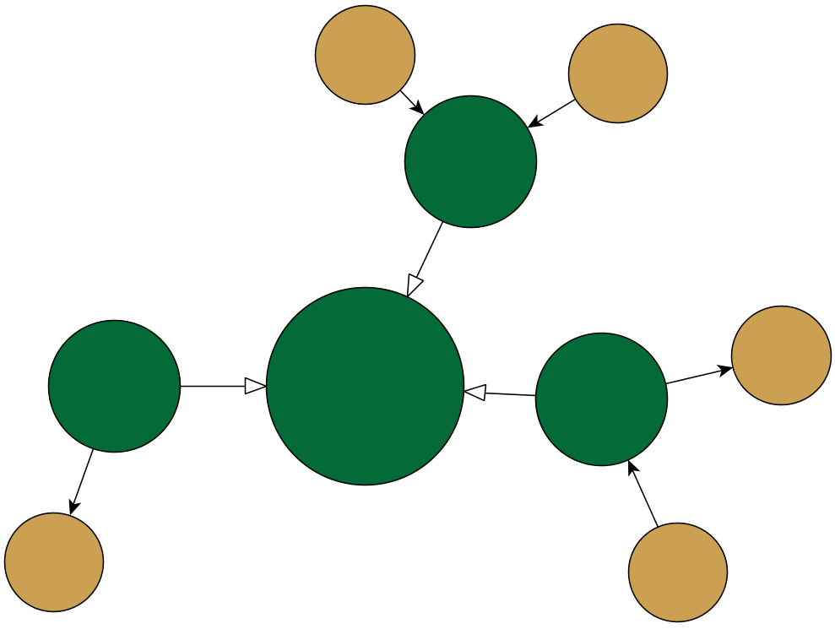
Knowledge Graphs
A graph structure to represent knowledge about data [6]
Two components: nodes and edges
Graph consists of triples in the form <node, edge, node>
Ontology: defines how to structure the data
Uses RDF format
Notes:
So, with the problem of too much unstructured data that is difficult to keep track of, the solution is to put it in a more structured form that can be queried to find specific patterns. The data structure that will be used is called a knowledge graph, which is a graph structure (that is directed in this case) that represents knowledge about data. Knowledge just refers to the facts known about the data, so representing the data in this way facilitates finding patterns.
The two main components of a knowledge graphs are called nodes and edges. Nodes are the objects of specific pieces of data, and edges are relations that define how the data interacts with each other. These relations are how we can represent knowledge about the data.
When materializing the graph, it turns into the form of triples that contain node, edge, node, where the first node is the subject of a relation, the edge is the relation itself, and the second node is the object of the relation. So for example, if we have two nodes of student and class, then a triple that could be part of a graph would be <student, attends, class>. When given specific data to input into the graph, it would contain something like <Alice, attends, Data Structures>.
While the knowledge graph is the graphical structure of the data, we can say that the ontology is the thing that defines how we will structure the data. The ontology defines all the kinds of objects and relations there can be in the graph, and which objects can have which relations. So after the ontology is developed, then the data can be inserted in through a process called materialization to fit into these objects and relations.

Slide 8
Approach
Competency Questions and Data set
Schema and Ontology
Knowledge Graph
Notes:
The approach for this contains a few steps. First, Competency questions were created and a dataset was chosen. Next, the schema for how the data was going to be organized was designed. The ontolgy was developed based on the schema, and the knowledge graph was materialized using the ontology as the base.

Slide 9
Competency Questions and Choosing a Dataset
Is there any suspicious networking activity in the executable?
Competency Questions: derived from the use case of the ontology to specify what questions the knowledge graph should be able to answer
Data: repository of unix-based executable files [6]
Can sections of entropy be detected through the ratio of unique opcodes and total number of instructions in a function?
What percentage of the functions in the binary file are imported?
Notes:
The first step of designing a knowledge graph is identifying what you want the knowledge graph to do. Aka, what questions do you want the KG to answer, or what problems do you want it to solve. These questions are based on the use case of the KG, which in our case, the use case is detecting malicious behavior in executables. All 10 competency questions are listed on this slide. The questions that I mostly focus my research on are:
2. "Is there any suspicious networking activity within the executable?"
4. Can sections of entropy be detected through the ratio of unique opcodes and total number of instructions in a function?"
10. What percentage of the functions in the binary file are imported (are external)?"
These questions, while originally developed during the start of this process, were modified throughout while what was possible with the data was discovered in more detail throughout the development process.
For the data chosen for this research, a repository of both benign and malicious exectuable ELF (executable and linkable format) files were chosen. The ELF format is unix-based with unique names for certain API calls that differ from windows executables, so the queries made after the materialization process take this into account.

Slide 10
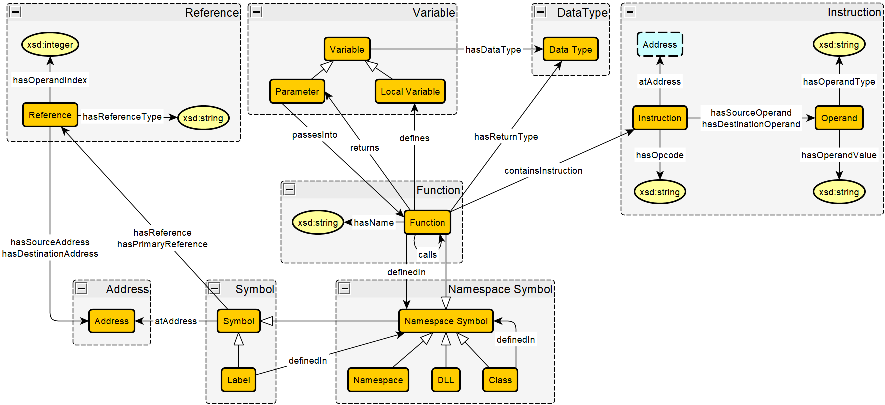
Designing the Shema
Designed using yEd [7]
Based on Symbol Tree in Ghidra
Symbol & Subclasses
Label
Namespace Symbol
Instruction objects
Define axioms
Notes:
The schema for how I organized the data was made through the yEd graph editor.
The schema is based on the symbol tree in ghidra, which organizes all the data based on where it is located in terms of symbols. In Ghidra, a symbol is a human readable name for a memory address, allowing for labeling of parts of data to better understand how they work. Ghidra categorizes symbols into 6 categories; namespaces, classes, functions, labels, imports, and exports. All of these have their own objects represented in the schema (with imports and exports being represented as DLLs (dynamically linked libraries)).
The main module of this schema is for the symbol object (since the schema is modeled on the symbol table). There are two types of symbols, labels, which act like variables outside of functions, and namespace symbols, which can define other symbols within themselves. Namespaces, DLLs, Classes, and functions are all subclasses of the namespace symbol. So classes can be defined in namespaces, functions can be defined in DLLs, and so on. Another important part of the schema is the instruction module, where functions contain multiple instructions. These instructions with their opcodes and operands specified is one of the primary ways malicious patterns are detected within the knowledge graph, especially detecting certain patterns of instructions within certain functions.
After this base structure was defined, axioms were constructed for the relations. An axiom is a constraint on a relation that defines how that relation can be used. Some important axioms defined that were used for constructing the ontology include the subclass relation, functionality, and domain and ranges of relations. Structuring the relations in this way helps structure the data and give certain limits for the data.

Slide 11
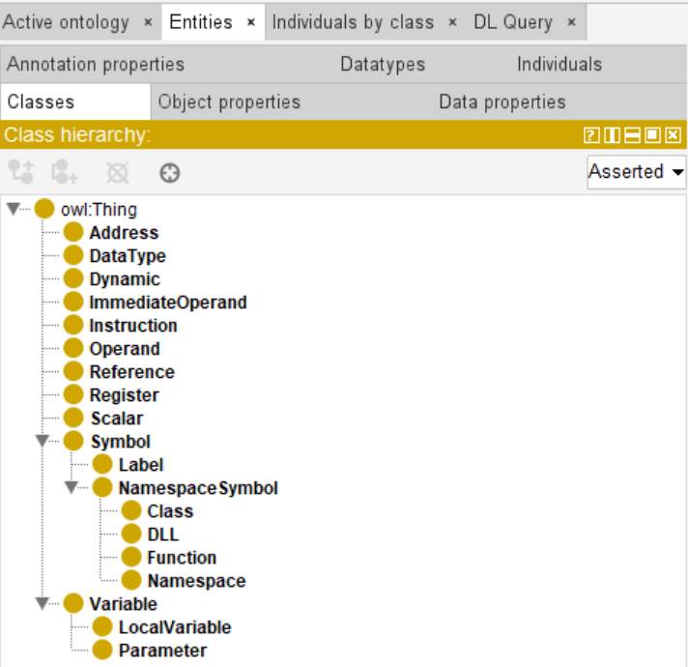
Developing the Ontology
Developed ontology in Protégé [8]
Contains classes (objects), object properties, and data properties
Axioms, domain, and range specified for all relations
Saves ontology into turtle (ttl) format
Basis of knowledge graph
Notes:
After the schema and axiomization was specified, the ontology was developed based on the schema using a software called protégé.
The main parts of this include the objects (or classes as they are called in protégé), the object properties (which are the relations between two objects), and the data properties (which are relations that link an object and a literal value together, like how an instruction has an opcode that is represented by a literal string).
The ontology was based directly on the schema, with all the objects and relations from the schema translated into protégé. The axioms defined for the schema are also put into protégé through a functionality option for relations (to define if a given relation has the functionality axiom, or the fact that there can only be a max of one of those relations for a given object in the domain). Protégé also allows for specifying the domain and range of the relations, which specify which objects can be at either end of the relation.
After the ontology has finished development within protégé, it can be exported into multiple different RDF files. For this project, it was saved in the turtle format since it was the easiest format to use to help with the knowledge graph materialization later.

Slide 12
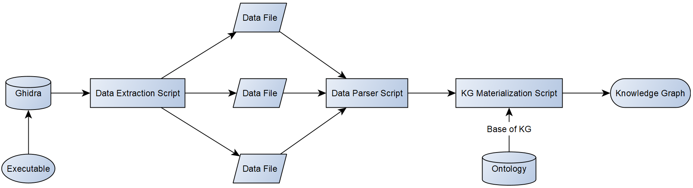
Generating a Knowledge Graph
Data extraction
Extract data about file from Ghidra Analysis
Data parsing
Parse data into dictionaries
Materialization
Materialize KG by making triples based on data and ontology
Figure made in yEd [7]
Notes:
After the ontology was developed, then we went into the process of materializing the knowledge graph. This consisted of a few different steps.
The first is data extraction. After a given executable file was analyzed by Ghidra, I utilized the Ghidra API to extract the specific data needed for the knowledge graph. The script that did this made many Ghidra API calls, then output the results of those into multiple data files.
Then, there is the data parsing script, which takes the data from all these files and organizes them into python dictionaries. These are put into lists of dictionaries for each kind of object.
Then, the materialization script calls the data parsing script to get all the dictionaries of the data. It then uses that to create the triples that will consist of the knowledge graph.
Within this script, the graph is initialized as an empty graph, then parses the ontology turtle file to add all the triples associated with that. Then, it iterates through all the lists of dictionaries for each object, then adds all the required triples for each object into the knowledge graph. After all the triples are added, the knowledge graph is exported into another turtle file, which is now ready to be queried.

Slide 13
Results
Evaluating Ontology Structure
Querying Knowledge Graph to detect patterns
Notes:
Now we get to the results section, which contains two main parts. First is evaluating the ontology itself, and the second is querying the resulting knowledge graphs to detect the malicious behavior.

Slide 14
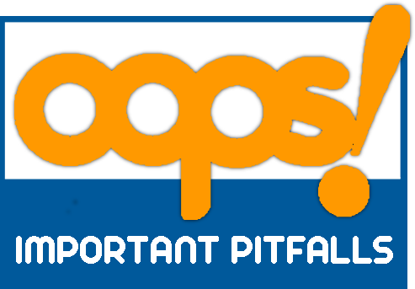
Ontology
Used OOPS! Ontology Pitfall Scanner to evaluate ontology [9]
Multiple major pitfalls were fixed
Few pitfalls identified but disregarded for the current scope
Recursive definition
Equivalent classes not explicitly declared
No explicitly defined inverse relations
Notes:
Some of the pitfalls that were pointed out by the pitfall scanner and fixed include missing domain and range elements from relations, missing annotations, and missing a specification for what objects are disjoint with each other. This tool overall made the ontology more robust and complete.
There were some pitfalls that the tool caught, but were disregarded for one reason or another due to the limited time constraint for this research. The first one is a recursive definition for the function object, where it is both defined in and a subclass of the namespace symbol object. I decided to ignore this warning as I thought it was important for the structure of the ontology to specify that a function is a type of namespace, and that it can be defined in all types of namespace variables, including functions themselves.
The second pitfall was for equivalent classes not explicitly stated for the address and reference class. My guess is that the pitfall scanner caught this pitfall by the names and assumed that they are the same object since other ontologies usually use the term interchangeably. However, I wanted to make the distinction between these two since a reference is for a link between two memory addresses.
The third is no explicitly defined inverse relations, where the hasDataType and hasReturnType have no inverse relation defined. I decided not to define any inverse relations for these, since specifying that a certain data type is used as a data type for a variable or a return type for a function does not give any meaningful purpose. In future work for this research, I will most likely modify the ontology to have the Data Type object not be defined as an object, but as a string that signifies what the data type is since it is not used for anything else.

Slide 15
SPARQL Queries
Query based on competency question: "Can sections of entropy be detected through the ratio of unique opcodes and total number of instructions in a function?"
SPARQL Protocol and RDF Query Language
Drafted queries based on the competency questions
Used Apache Jena Fuseki to run queries against KG [10]
Showcasing the most interesting results in DHT
SELECT ?function
(COUNT(DISTINCT ?opcode) AS ?uniqueOpcodes)
(COUNT(?instruction) AS ?totalInstructions)
((COUNT(DISTINCT ?opcode) * 1.0 / COUNT(?instruction)) AS ?entropyRatio)
WHERE {
?function ontology:containsInstruction ?instruction .
?instruction ontology:hasOpcode ?opcode .
}
GROUP BY ?function
HAVING (?totalInstructions > 10)
ORDER BY DESC(?entropyRatio)
Notes:
The next part is developing the SPARQL queries to query the knowledge graphs. SPARQL stands for SPARQL Protocol and RDF Query Language, and it's just the query language used for data in the RDF format (aka, the knowledge graph). The queries made were based on the competency questions defined earlier in the presentation. There was at least one query created for each competency question, but I will just go over a few of the most interesting results in this presentation.
The query showcased here is based on the 4th competency question, which asks about finding entropy within functions. In this query, it finds function with 10 or greater instructions, then sorts them by the percentage of unique opcodes contained in the instructions and the total number of instructions in the given function. The more unique opcodes there are compared to total instructions, the more entropy is contained in the function.
After the queries were created, a software called apache jena fuseki was used to input the turtle file of the knowledge graph, then run the queries against it to get the results.

Slide 16
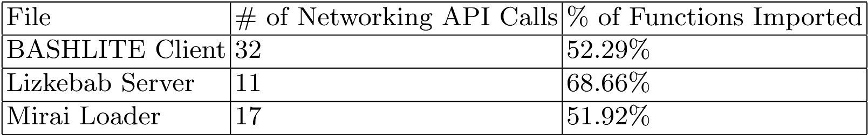
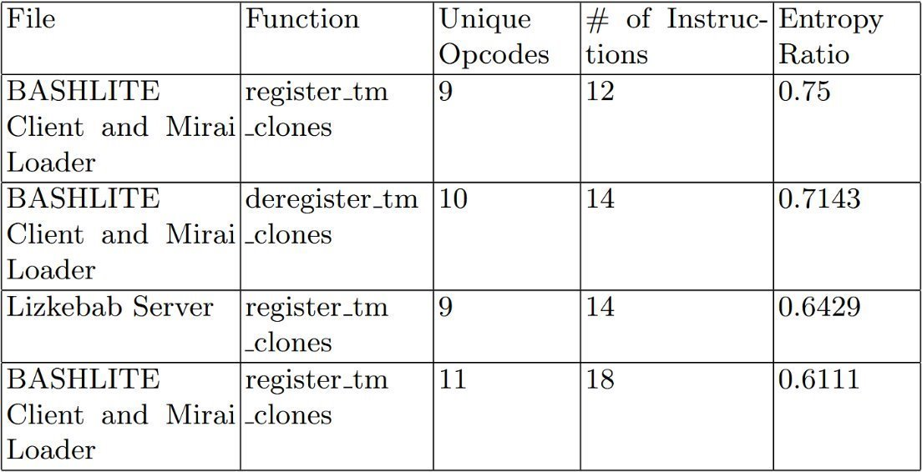
Analysis
BASHLITE: botnet that conducts DOS attacks on IoT devices
Lizkebab: variant of BASHLITE
Mirai: successor of BASHLITE [11]
Patterns that indicate malware:
Noticeable differences in the number of networking API calls
High percentages of imported functions
High entropy ratios in certain functions
Notes:
I will showcase the three most interesting results I found through the process.
The first one is the number of networking API calls, or instances where the program connects to the network. Higher numbers of these networking calls can potentially indicate that a bot is connecting to a malicious server and either getting instructions of what to do from the server or sending sensitive data from the victim’s system to the server.
Another pattern to look for is high percentages of imported functions, or functions that are defined in external libraries from the program. These are also suspicious, since malware often uses external libraries of malicious code, so less of the malicious behavior is detected internally within the program.
One more indicator is the amount of entropy within functions, or the randomness observed of the code. This randomness can indicate functionality that is not immediately obvious, which usually indicates part of the code is encrypted or obfuscated to hide its malicious purpose.

Slide 17
Conclusion
Knowledge graphs were successfully materialized and queried to detect malicious behavior
Future work:
Restructure ontology to better fit OOPS! Pitfall scanner
Expand ontology to include more parts of Ghidra analysis
Construct more robust queries to detect other forms of malicious behavior within different executable formats
Notes:
So, I was successfully able to generate knowledge graphs based on malicious executable files, then detected different kinds of malicious patterns for different kinds of malicious executables.
For future work, I hope to modify the ontology so it fits the OOPS pitfall scanner a little better, expand the ontology to include more parts of the Ghidra analysis, and construct more robust queries to detect more kinds of malicious behavior.
Currently, the queries are specifically designed for the ELF executable format, which have different API names than other executable formats like windows executables. While the knowledge graph itself should theoretically work with other forms of executables, more queries would have to be made to find these specific patterns.
Also, many of the queries rely on knowing specific API call names, which are not always clearly stated if a given file is obfuscated to hide the function names. In this case, more queries looking at specific behavior and patterns should be created so malicious patterns can be found even when data obfuscation occurs.

Slide 18
Works Cited
[1] J. Ferdous, R. Islam, A. Mahboubi and M. Z. Islam, "A Review of State-of-the-Art Malware Attack Trends and Defense Mechanisms," in IEEE Access, vol. 11, pp. 121118-121141, 2023, doi: 10.1109/ACCESS.2023.3328351.
[2] E. Gandotra, D. Bansal, and S. Sofat, “Malware Analysis and Classification: A Survey,” Journal of Information Security, vol. 05, no. 02, pp. 56–64, 2014, doi: https://doi.org/10.4236/jis.2014.52006.
‌[3] S.-Y. Yu, Achamyeleh, Yonatan Gizachew, C. Wang, A. Kocheturov, P. Eisen, and M. Abdullah, “CFG2VEC: Hierarchical Graph Neural Network for Cross-Architectural Software Reverse Engineering,” arXiv.org, 2023. https://arxiv.org/abs/2301.02723
‌[4] C. Eagle and K. Nance, The Ghidra Book: The Definitive Guide. San Francisco, CA, USA: No Starch Press, 2020.
[5] N. Partush, “GitHub - nimrodpar/Labeled-Elfs” GitHub, 2025. https://github.com/nimrodpar/Labeled-Elfs (accessed Apr. 22, 2026).
[6] A. Hogan et al., “Knowledge Graphs,” ACM Computing Surveys, vol. 54, no. 4, pp. 1–37, May 2022, doi: https://doi.org/10.1145/3447772.

Slide 19
Works Cited
[7] yWorks GmbH, yEd Graph Editor, version [Insert Version, e.g., 3.20]. [Online]. Available: https://www.yworks.com/products/yed.
[8] Musen, M.A. The Protégé project: A look back and a look forward. AI Matters. Association of Computing Machinery Specific Interest Group in Artificial Intelligence, 1(4), June 2015. DOI: 10.1145/2557001.25757003.
[9] M. Poveda-Villalón, A. Gómez-Pérez, and M. C. Suárez-Figueroa, "OOPS! (OntOlogy Pitfall Scanner!): An On-line Tool for Ontology Evaluation," International Journal on Semantic Web and Information Systems (IJSWIS), vol. 10, no. 2, pp. 7-34, Apr. 2014, doi: 10.4018/ijswis.2014040102.
[10] Apache Software Foundation, 2021. Apache Jena, Available at: https://jena.apache.org/.
[11] A. Marzano et al., “The Evolution of Bashlite and Mirai IoT Botnets,” IEEE Xplore, Jun. 01, 2018. https://ieeexplore.ieee.org/abstract/document/8538636?casa_token=mqQ4rYCpb6AAAAAA:bHUXfCbJXT30Ta_bSpdfkO946mNZgR1bm2EM9kRJY5hyPLim8SAKYWey9wZlpj0TZQ0CaGpxmonv (accessed April 22, 2026).

Slide 20
GitHub Project Repository
https://github.com/22lavonne/Malware-Behavior-Knowledge-Graph

